Slide 1
Time Series

Slide 2
introduction
Time Series Analysis is the way of studying the characteristics of the response variable with respect to time, as the independent variable.
To estimate the target variable in the name of predicting or forecasting, use the time variable as the point of reference

Slide 3
Continue..
A Time-Series represents a series of time-based
orders. It would be Years, Months, Weeks, Days, Horus, Minutes, and Seconds
A time series is an observation from the sequence of discrete-time of successive intervals and it is running chart
The time variable/feature is the independent variable and supports the target variable to predict the results.
It is used in different fields for time-based predictions – like Weather Forecasting, Financial, Signal processing, Engineering domain – Control Systems, Communications Systems and involves producing the set of information in a particular sequence, it makes a distinct from spatial and other analyses.

Slide 4
Components for Time Series Analysis
Trend: In which there is no fixed interval and any divergence within the given dataset is a continuous timeline. The trend would be Negative or Positive or Null Trend
Seasonality: In which regular or fixed interval shifts within the dataset in a continuous timeline. Would be bell curve or saw tooth
Cyclical: In which there is no fixed interval, uncertainty in movement and its pattern
Irregularity: Unexpected situations/events/scenarios and spikes in a short time span.

Slide 5
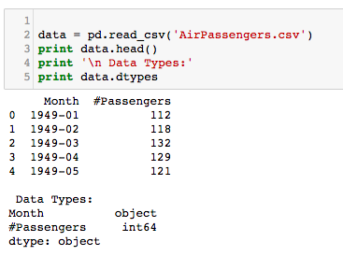
The dataset we will be using is a multi-variate time series having hourly data for approximately one year, for air quality in a significantly polluted Italian city. The dataset can be downloaded from the link given below:
import pandas as pd
import numpy as np
import matplotlib.pylab as plt
%matplotlib inline

Slide 6
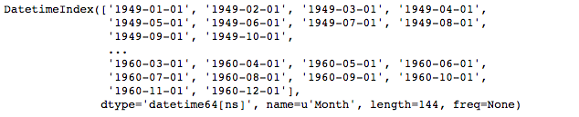
The data contains a particular month and number of passengers travelling in that month .The data type here is object (month) Let’s convert it into a Time series object and use the Month column as our index
Converting to datetime object and set as index
from datetime import datetime
con=data['Month']
data['Month']=pd.to_datetime(data['Month'])
data.set_index('Month', inplace=True)
#check datatype of index
data.index

Slide 7
STATIONARITY
When we apply a time series model, it is important for the Time series to be stationary it means statistical properties (mean,variance) remain constant over time.
Properties are:
• constant mean
• constant variance
• an auto co-variance that does not depend on time.
The best way to understand stationarity in a Time Series is by eye-balling the plot
ts = data['#Passengers']
ts.head(10)

Slide 8
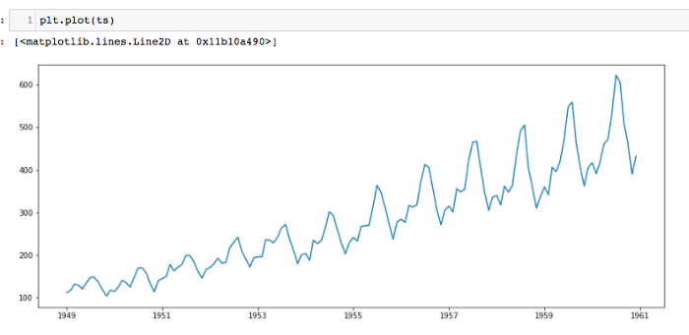

Slide 9
So overall there is an uprising trend with some seasonality in it
There is a code that we will be using for quite often, before that lets look at what the concept of the functions

Slide 10
Plotting rolling statistics
The function will plot the moving mean or moving standard deviation. This is still visual method
Note : moving mean and moving standard deviation at any instant we take the mean / std of the last year which in case 12 months

Slide 11
Dickey fuller test
This is one of the statistical tests for checking stationary the result from the test will contain the test statistics and critical value for different confidence levels, the idea is to have the test statistics less than critical value in this cause we can reject the null hypothesis and say this time series is indeed stationary

Slide 12
Function details
Mean
Standard deviation (instead of variance)
Plot original series
Plot mean
Plot std
Plot dickey fuller test

Slide 13
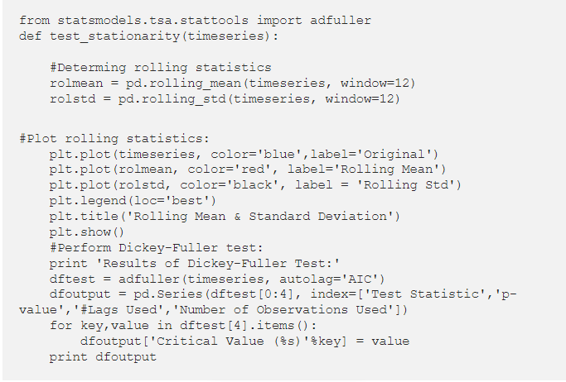

Slide 14
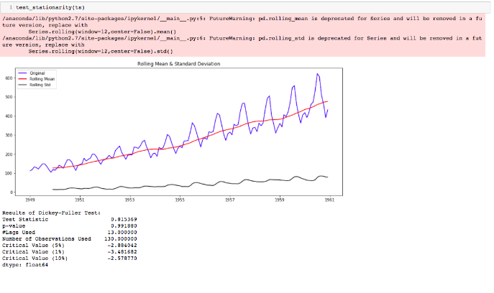
Data in action

Slide 15
This is not stationary because
Means is increasing even though the std is small
Test stat is > critical value
Note : the signed values are compared and the absolute values

Slide 16
Making the times series stationary
There are two major factors that make a time series non-stationary. They are:
• Trend: non-constant mean
• Seasonality: Variation at specific time-frames
The basic idea is to model the trend and seasonality in this series, so we can remove it and make the series stationary.
Then we can go ahead and apply statistical forecasting to the stationary series.
And finally we can convert the forecasted values into original by applying the trend and seasonality constrains back to those that we previously separated.

Slide 17
Let’s start by working on the trend piece.
Trend
The first step is to reduce the trend using transformation, as we can see here that there is a strong positive trend. These transformation can be log, sq-rt, cube root etc . Basically it penalizes larger values more than the smaller. In this case we will use the logarithmic transformation.

Slide 18
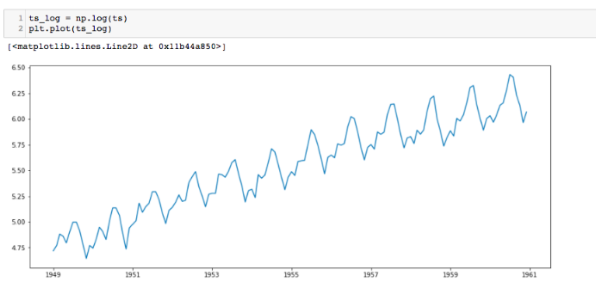

Slide 19
There is some noise in realizing the forward trend here. There are some methods to model these trends and then remove them from the series. Some of the common ones are:
• Smoothing: using rolling/moving average
• Aggression: by taking the mean for a certain time period (year/month)
I will be using Smoothing here.

Slide 20
Smoothing
In smoothing we usually take the past few instances (rolling estimates) We will discuss two methods under smoothing- Moving average and Exponentially weighted moving average.

Slide 21
Moving average
First take x consecutive values and this depends on the frequency if it is 1 year we take 12 values. Lucky for us that Pandas has a function for rolling estimate (“alright alright alright” -Matthew McConaughey!)

Slide 22
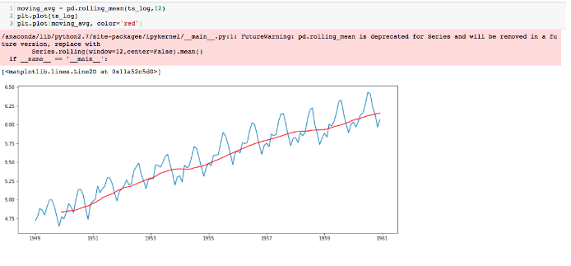
Now subtract the rolling mean from the original series.

Slide 23
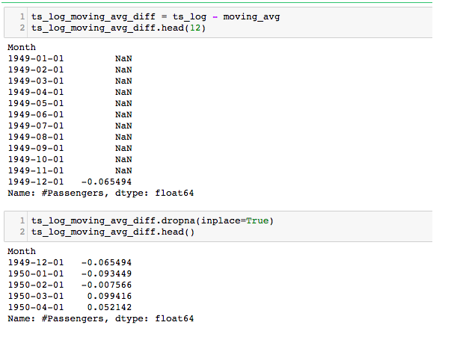

Slide 24
The reason there are null values is because we take the average of first 12 so 11 values are null. We can also see that in the visual representation. Thus it is dropped for further analysis. Now let’s parse it to the function to check for stationarity.

Slide 25
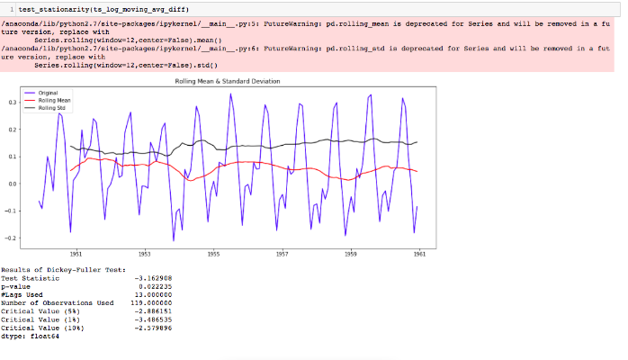

Slide 26
We notice two things:
• The rolling values are varying slightly but there is no specific trend.
• The test statistics is smaller than the 5 % critical values. That tells us that we are 95% confident that this series is stationary.
In this example we can easily take a time period (12 months for a year), but there are situations where the time period range is more complex like stock price etc. So we use the exponentially weighted moving average (there are other weighted moving averages but for starters, lets use this). The previous values are assigned with a decay factor. Pandas again comes to the rescue with some awesome functions for it, like:

Slide 27
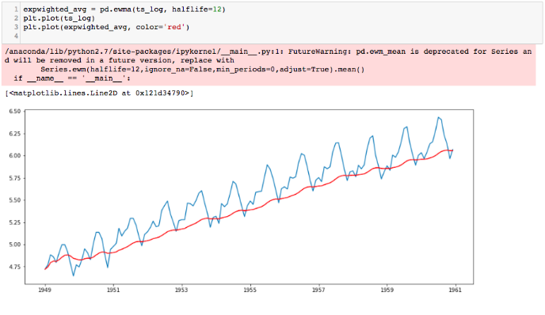
the parameter (halflife) is assumed 12, but it really depends on the domain. Let’s check stationarity now:

Slide 28
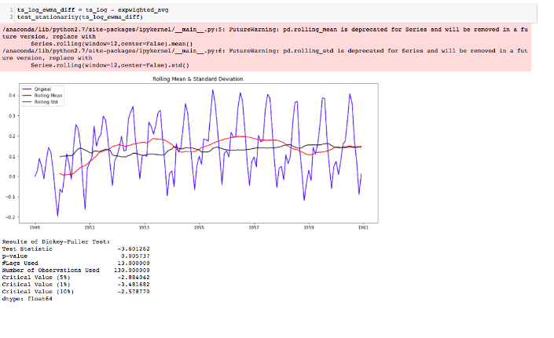

Slide 29
It is stationary because:
• Rolling values have less variations in mean and standard deviation in magnitude.
• the test statistic is smaller than 1% of the critical value. So we can say we are almost 99% confident that this is stationary.

Slide 30
Seasonality (along with Trend)
Previously we saw just trend part of the time series, now we will see both trend and seasonality. Most Time series have trends along with seasonality. There are two common methods to remove trend and seasonality, they are:
• Differencing: by taking difference using time lag
• Decomposition: model both trend and seasonality, then remove them

Slide 31
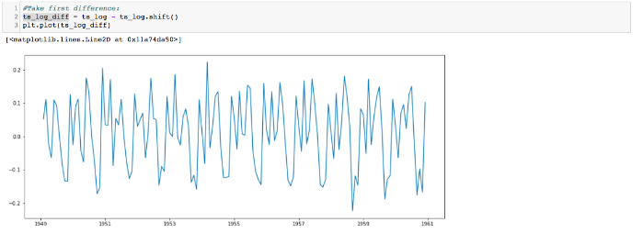
Differencing:
Here we first take the difference of the value at a particular time with that of the previous time. Now let’s do it in Pandas.

Slide 32
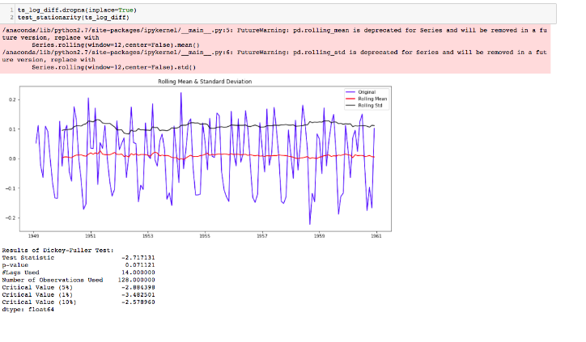

Slide 33
It is stationary because:
• the mean and std variations have small variations with time.
• test statistic is less than 10% of the critical values, so we can be 90 % confident that this is stationary.

Slide 34
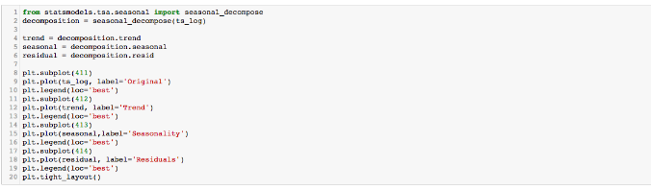
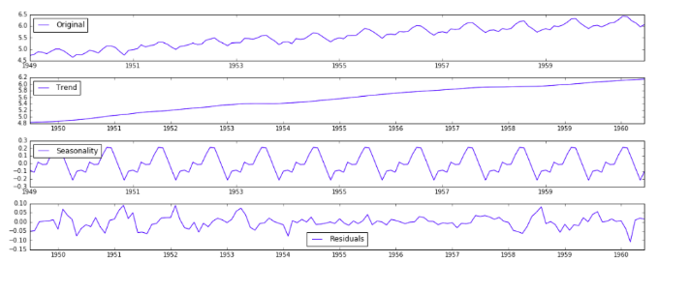
Decomposing:

Slide 35
Remove the trend and seasonality from the Time series and now we can use the residual values. Let’s check stationarity.

Slide 36
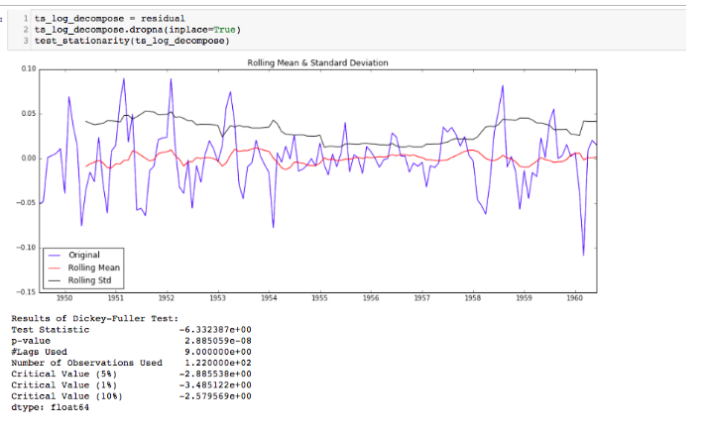

Slide 37
This is stationary because:
• test statistic is lower than 1% critical values.
• the mean and std variations have small variations with time.

Slide 38
Forecasting a Time Series
Now that we have made the Time series stationary, let’s make models on the time series using differencing because it is easy to add the error , trend and seasonality back into predicted values .
We will use statistical modelling method called ARIMA to forecast the data where there are dependencies in the values.
Auto Regressive Integrated Moving Average(ARIMA) — It is like a liner regression equation where the predictors depend on parameters (p,d,q) of the ARIMA model .

Slide 39
these dependent parameters:
p : This is the number of AR (Auto-Regressive) terms . Example — if p is 3 the predictor for y(t) will be y(t-1),y(t-2),y(t-3).
• q : This is the number of MA (Moving-Average) terms . Example — if p is 3 the predictor for y(t) will be y(t-1),y(t-2),y(t-3)
• d :This is the number of differences or the number of non-seasonal differences .

Slide 40
Now let’s check out on how we can figure out what value of p and q to use. We use two popular plotting techniques; they are:
Autocorrelation Function (ACF): It just measures the correlation between two consecutive (lagged version). example at lag 4, ACF will compare series at time instance t1…t2 with series at instance t1–4…t2–4
• Partial Autocorrelation Function (PACF): is used to measure the degree of association between y(t) and y(t-p).

Slide 41
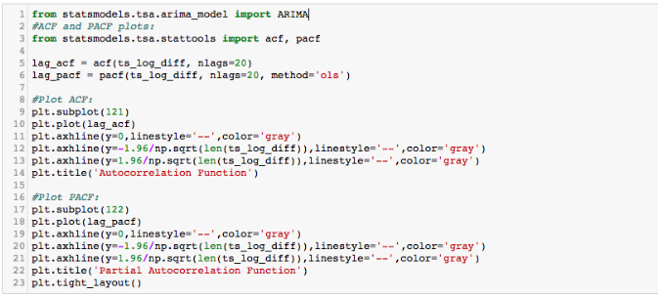
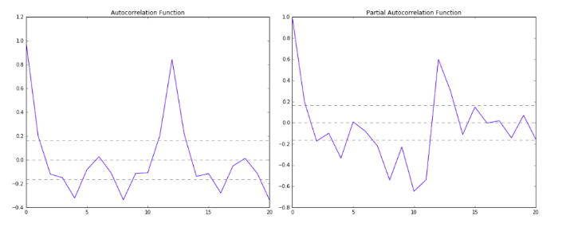

Slide 42
The two dotted lines on either sides of 0 are the confidence intervals. These can be used to determine the ‘p’ and ‘q’ values as:
• p: The first time where the PACF crosses the upper confidence interval, here its close to 2. hence p = 2.
• q: The first time where the ACF crosses the upper confidence interval, here its close to 2. hence p = 2.

Slide 43
ARIMA
ARIMA, short for ‘Auto Regressive Integrated Moving Average’ is actually a class of models that ‘explains’ a given time series based on its own past values, that is, its own lags and the lagged forecast errors, so that equation can be used to forecast future values
Predicted Yt = Constant + Linear combination Lags of Y (upto p lags) + Linear Combination of Lagged forecast errors (upto q lags)

Slide 44
Now, using this make 3 different ARIMA models considering individual as well as combined effects. we will also print the RSS for each. Please note that here RSS is for the values of residuals and not actual series.

Slide 45
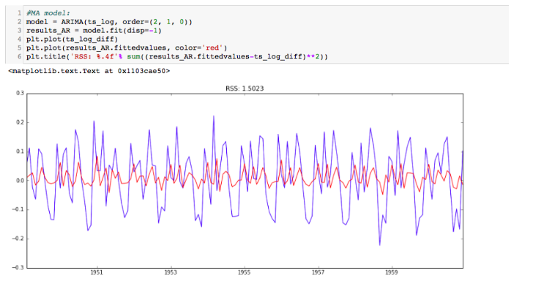
AR Model

Slide 46
AR Model

Slide 47
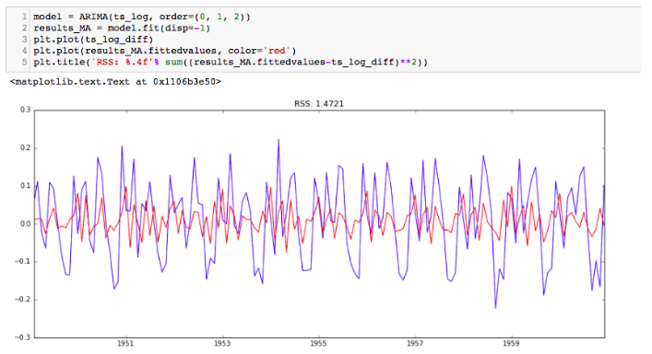
MA Model

Slide 48
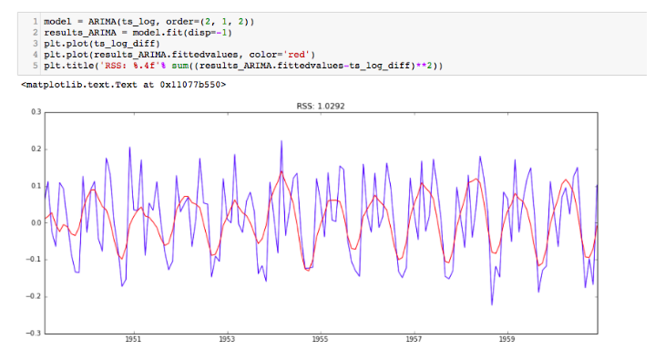
ARIMA MODEL

Slide 49
RSS values:
• AR=1.5023
• MA=1.472
• ARIMA =1.0292
ARIMA has the best RSS values.

Slide 50
FINAL STEP:
BRINGING THIS BACK TO THE ORIGINAL SCALE
First get the predicted values and store it as series. You will notice the first month is missing because we took a lag of 1(shift).
• Now convert differencing to log scale: find the cumulative sum and add it to a new series with a base value (here the first-month value of the log series).

Slide 51
First get the predicted values and store it as series. You will notice the first month is missing because we took a lag of 1(shift).
Now convert differencing to log scale: find the cumulative sum and add it to a new series with a base value (here the first-month value of the log series).

Slide 52
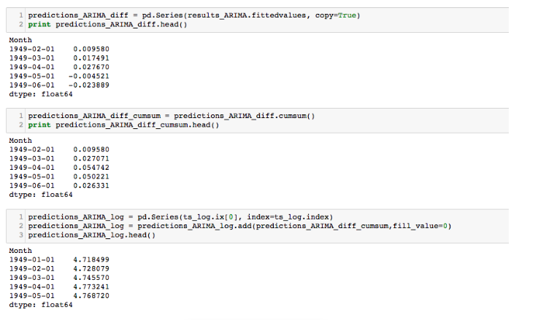

Slide 53
Next -take the exponent of the series from above (anti-log) which will be the predicted value — the time series forecast model.
Now plot the predicted values with the original.
• Find the RMSE

Slide 54
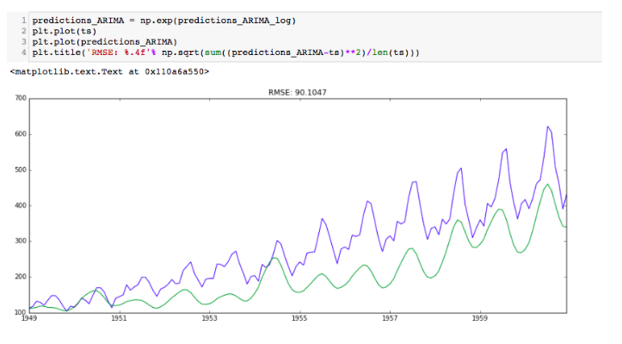

Slide 55
Non-stationary
Non-stationary data, as a rule, are unpredictable and cannot be modeled or forecasted. The results obtained by using non-stationary time series may be spurious in that they may indicate a relationship between two variables where one does not exist.

Slide 56
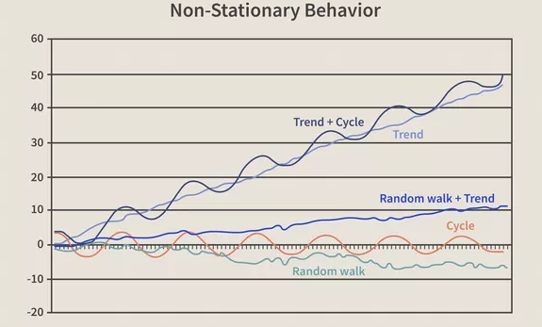

Slide 57
Exponential Smoothing
Exponential smoothing is a time series forecasting method for univariate data that can be extended to support data with a systematic trend or seasonal component.
Exponential smoothing forecasting methods are similar in that a prediction is a weighted sum of past observations, but the model explicitly uses an exponentially decreasing weight for past observations.

Slide 58
Types of Exponential Smoothing
Single Exponential Smoothing
Single Exponential Smoothing, SES for short, also called Simple Exponential Smoothing, is a time series forecasting method for univariate data without a trend or seasonality.
It requires a single parameter, called alpha (a), also called the smoothing factor or smoothing coefficient.
This parameter controls the rate at which the influence of the observations at prior time steps decay exponentially.
Alpha is often set to a value between 0 and 1.
Large values mean that the model pays attention mainly to the most recent past observations, whereas smaller values mean more of the history is taken into account when making a prediction

Slide 59
single exponential smoothing
...
from statsmodels.tsa.holtwinters import SimpleExpSmoothing
# prepare data
data = ...
# create class
model = SimpleExpSmoothing(data)
# fit model
model_fit = model.fit(...)
# make prediction
yhat = model_fit.predict(...)

Slide 60
Double Exponential Smoothing
It is an extension to Exponential Smoothing that explicitly adds support for trends in the univariate time series.
In addition to the alpha parameter for controlling smoothing factor for the level, an additional smoothing factor is added to control the decay of the influence of the change in trend called beta (b).
The method supports trends that change in different ways: an additive and a multiplicative, depending on whether the trend is linear or exponential respectively.
DES with an additive trend is classically referred to as Holt’s linear trend model, named for the developer of the method Charles Holt.

Slide 61
# double or triple exponential smoothing
...
from statsmodels.tsa.holtwinters import ExponentialSmoothing
# prepare data
data = ...
# create class
model = ExponentialSmoothing(data, ...)
# fit model
model_fit = model.fit(...)
# make prediction
yhat = model_fit.predict(...)

